Slide 1
Test Levels; Types of Testing
420-E31 Systems III
References:
http://softwaretestingfundamentals.com/unit-testing/
http://www.agiledata.org/essays/tdd.html
http://www.tassq.org/quarterly/docs/tassq_magazine-0609.pdf
Bernard Homes. Fundamentals of Software Testing, 2012
Crispin & Gregory. Agile Testing, 2010

Slide 2
Overview
Static versus Dynamic testing
Black box versus White box testing
Testing Levels
Unit, integration, system, acceptance testing
Testing types
Compatibility, regression, beta, functional vs non-functional, performance, usability, accessibility, security, exploratory

Slide 3
Static and Dynamic Testing
Static Testing
Testing something that is not running by examining and reviewing it.
Examples: Code inspections
Dynamic Testing
Testing software by running and using it.
Notes:
Analogy – buying used car. Static – kicking tires, looking under hood. Dynamic – test drive

Slide 4
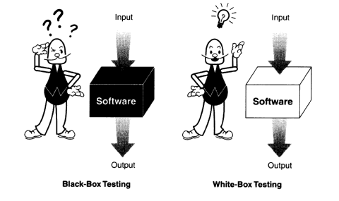
Black Box vs. White Box Testing

Slide 5
Black Box Testing
Tester knows what software is supposed to do, but cannot look in it (the box) to see how it operates.
Notes:
Risk – easy to become biased because tests may be tailored to match code’s operation

Slide 6
White Box Testing
Also called Clear Box or Glass Box Testing
Tester has access to the code and can examine it for clues to help with the testing.
Tester may determine that certain conditions are more or less likely to fail and tailor testing based on that.
Notes:
Risk – easy to become biased because tests may be tailored to match code’s operation

Slide 7
Static White Box Testing
Methodically reviewing software design, architecture, or code without running it.
Also called structural analysis
Increases chances of finding an error or defect early
Notes:
Analogy – buying used car. Static – kicking tires, looking under hood. Dynamic – test drive

Slide 8
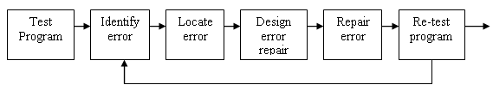
Dynamic White Box Testing vs. Debugging
Goal of dynamic white box testing
Find bugs
Goal of debugging
Fix bugs
Overlap
Isolate where and why bug occurs
Notes:
Too many developers make it the same thing…must make it two steps

Slide 9
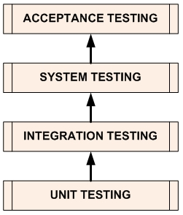
Testing Levels
System is tested for acceptability by users
Complete integrated software is tested
Individual units combined & tested as group
Individual units/ components of software/ system are tested
Notes:
Source: http://softwaretestingfundamentals.com/software-testing-levels/

Slide 10
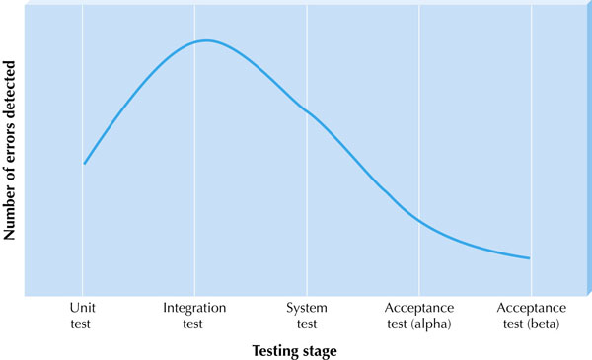
Bugs Found in Each Testing Level

Slide 11
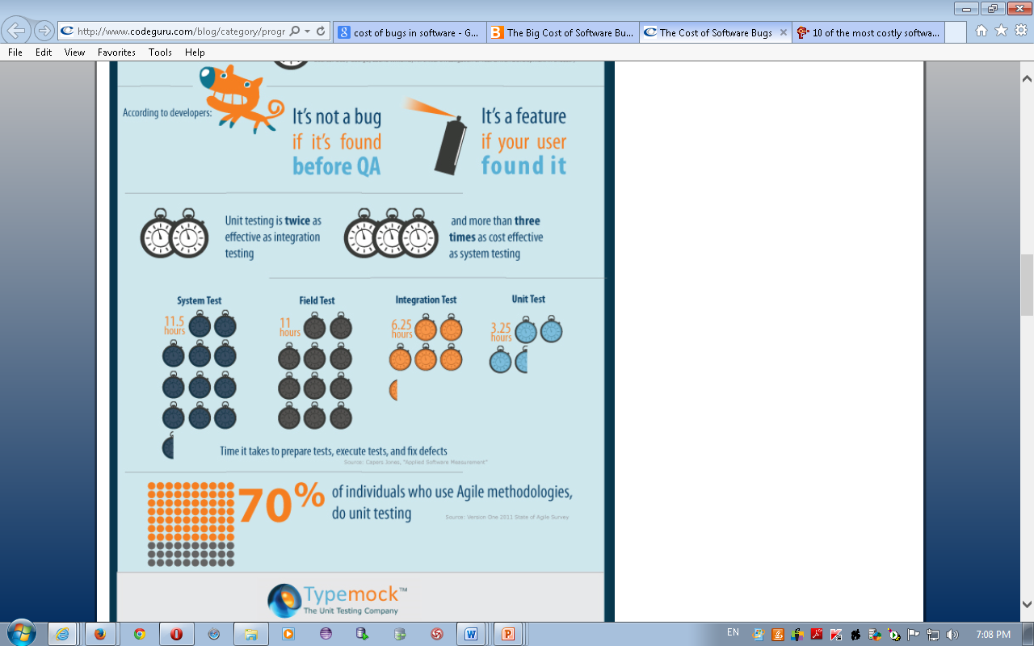
Notes:
http://www.codeguru.com/blog/category/programming/the-cost-of-bugs.html

Slide 12
Test Level 1: Unit Testing
Purpose: Validate that each unit of the software performs as designed. Unit is the smallest testable part of software, e.g. method.
Method: White box testing
When: As unit is developed. First level of testing
Who: Typically performed by the developer as the unit is developed

Slide 13
Test Level 2: Integration Testing
Purpose: Expose faults in the interaction between integrated units.
Method: White or black box testing
When: After unit test and before system test
Who: Either the developers themselves or independent testers

Slide 14
Integration Testing Approaches
Big Bang – all units are combined together and tested at once.
Top down – top level units are tested first and lower level units are tested after. Test stubs needed to simulate lower level units not yet available
Bottom up – bottom levels are tested first and upper level units are tested after. Test drivers needed to simulate higher level units not yet available
Sandwich/hybrid – combination of top down and bottom up

Slide 15
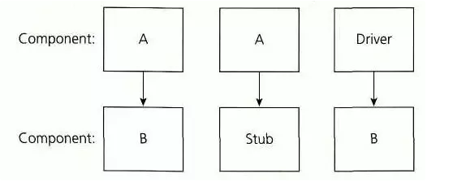
Top Down Testing
In this approach testing is conducted from main module to sub module. if the sub module is not developed a temporary program called STUB is used for simulate the submodule.
Notes:
The main control module is used as a test driver and stubs are substituted for all modules directly subordinate to the main control modules
Depending on the integration approach selected (depth or breadth first), subordinate stubs are replaced one at a time with actual modules.
Tests are conducted as each module is integrated.
On the completion of each set of tests, another stub is replaced with the real module.
Regression testing (i.e. conducting all or some of the previous tests) may be conducted to ensure that new errors have not been introduced.

Slide 16
Advantages (Top Down Testing)
Advantageous if major flaws occur toward the top of the program.
Early skeletal Program allows demonstrations and boosts morale.

Slide 17
Disadvantages (Top Down Testing)
Stub modules must be produced
Stub Modules are often more complicated than they first appear to be.
Before the I/O functions are added, representation of test cases in stubs can be difficult.
Test conditions maybe impossible, or very difficult, to create.
Observation of test output is more difficult.

Slide 18
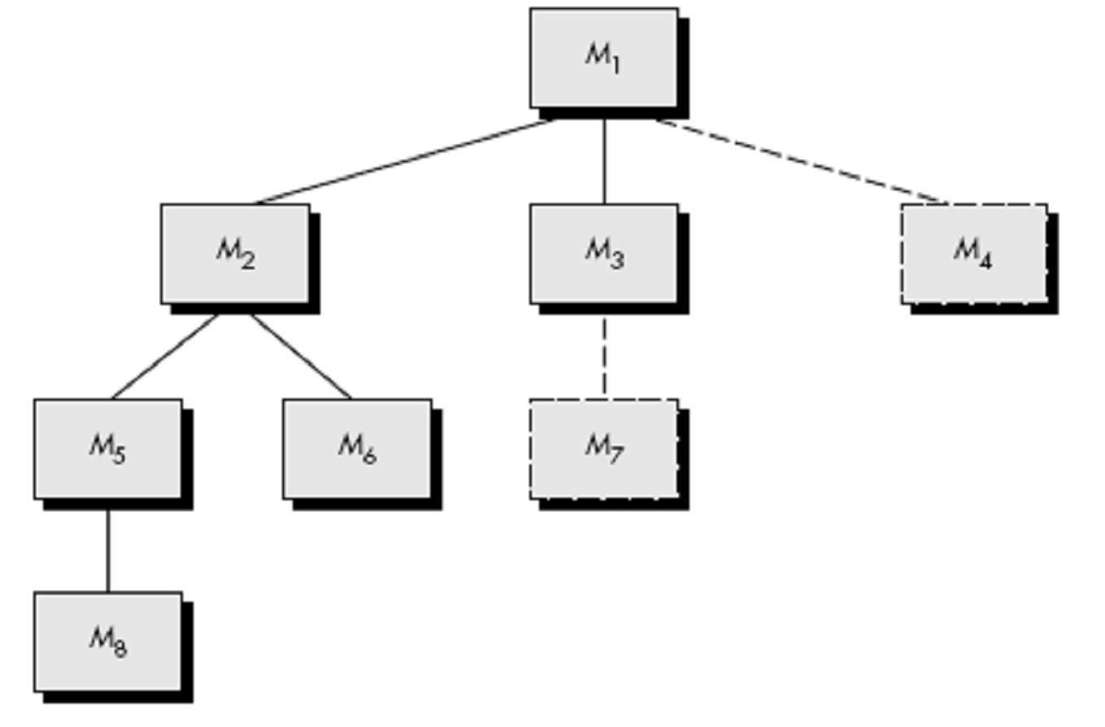
Top Down Testing
Source: http://www.csbdu.in/econtent/Software%20Quality%20and%20Testing/UNIT%20II.pdf
Notes:
What’s the best method

Slide 19
Bottom Up Testing
In this approach testing is conducted from sub module to main module, if the main module is not developed a temporary program called DRIVERS is used to simulate the main module.
Notes:
Use drivers to drive testing of modules
Low-level modules are combined into clusters (sometimes called builds) that perform a specific software subfunction.
A driver (a control program for testing) is written to co-ordinate test case input and output.
The cluster is tested.
Drivers are removed and clusters are combined moving upward in the program structure.

Slide 20
Advantages (Bottom Up Testing)
Advantageous if major flaws occur toward the bottom of the program.
Test conditions are easier to create.
Observation of test results is easier.

Slide 21
Disadvantages (Bottom Up Testing)
Driver Modules must be produced.
The program as an entity does not exist until the last module is added.

Slide 22
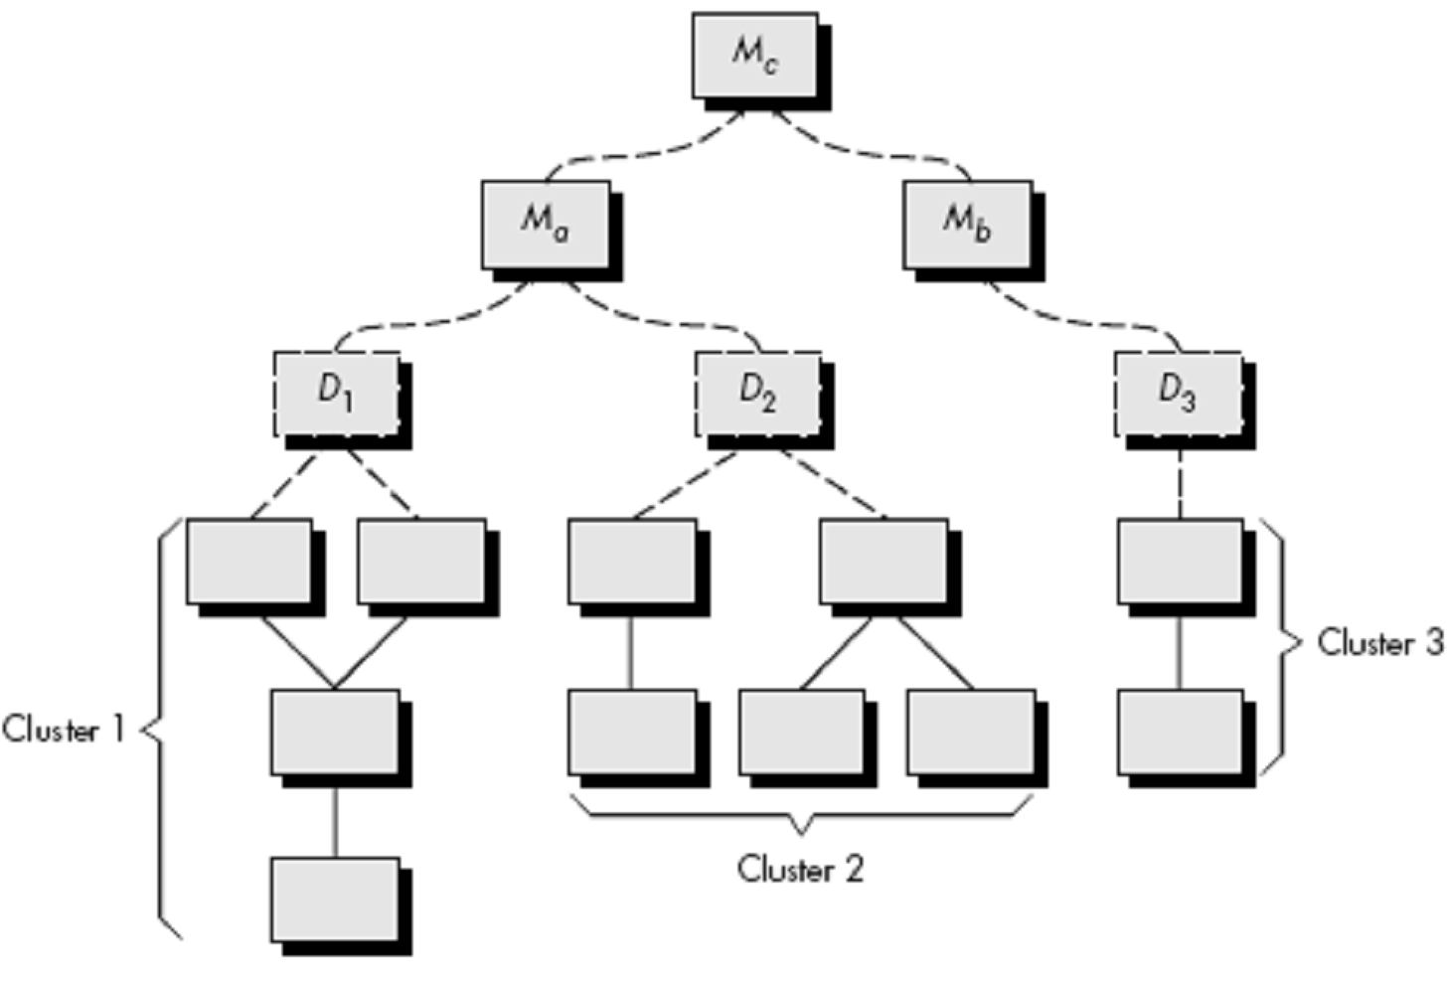
Bottom Up Testing
Source: http://www.csbdu.in/econtent/Software%20Quality%20and%20Testing/UNIT%20II.pdf

Slide 23
Unit Testing Technique
Decide if this is a bottom module or a higher level module
Determine how you will create test driver or stub
Create black box test cases first based on what is said in the specification
Check the code to make sure you’ve covered everything
Notes:
Confirm type of module can confirm this by looking at the code

Slide 24
Test Level 3: System Testing
Purpose: Evaluate system’s compliance with specified requirements.
Method: Black box testing
When: After integration testing and before acceptance testing.
Who: Typically independent testers

Slide 25
Test Level 4: Acceptance Testing
Purpose: Evaluate system’s compliance with business requirements and assess whether it is acceptable for delivery.
Method: Black box testing
When: After system testing
Who: Typically end users or customers

Slide 26
Types of Testing
There are many, many types of testing that are performed throughout the development process.

Slide 27
Regression Testing
Retesting of a previously tested program following modification
Ensure that faults have not been introduced or uncovered as a result of the changes made
These are automated tests.
Notes:
What is important when doing this…AUTOMATION
When should you regression test? Every drop/build…much better with automation

Slide 28
Exploratory Testing
Testers may interact with the application in whatever way they want and use the information the application provides to react, change course, and generally explore the application’s functionality without restraint.
Test design and execution at the same time
Popular in the Agile world

Slide 29
Exploratory Testing
Drawback: testers risk wasting a great deal of time wandering around an application looking for things to test and trying to find bugs.
This ad-hoc testing method is used in combination with structured testing methods.

Slide 30
User Interface Testing
Testing is done by moving through each and every menu in the system, either in a top down or bottom up approach.

Slide 31
Usability Testing
Tests how convenient the system is to use.
Critique the product.
Navigation is one aspect of usability testing – test links, tabbing order.

Slide 32
Usability Testing
Key attributes to look for in usability testing:
Accessibility – how easy can users enter, navigate and exit.
Responsiveness – how ready is the app to allow the user to accomplish goals.
Efficiency – Degree to which the number of required steps is minimal
Comprehensibility – How easy is product to understand? Good help?

Slide 33
Security Testing
Needs to ensure confidentiality and integrity of system.
Tests disaster recovery and unauthorized access.
Test authentication and authorization.
Variety of automated tools to help with things like SQL injection and cross-site scripting.
Perform both black and white box testing.

Slide 34
Interoperability Testing
Refers to the capability of diverse systems to work together and share information.
Looks at end-to-end functionality between 2 or more communicating systems.

Slide 35
Compatibility Testing
Project dependent – system needs to work with other applications.
If you have a web application, different browsers and operating systems are tested using compatibility testing.

Slide 36
Reliability Testing
That ability of a system to perform and maintain its functions in routine circumstances as well as unexpected circumstances.
The system must also perform and maintain its functions with consistency and repeatability.
Answers the question: “How long will it run before it breaks?”
MTBF = Mean Time Between Failures

Slide 37
Scalability Testing
Verifies that the application remains reliable when more uses are added.
Network can be a bottleneck.
Can the database scale?
Can the hardware handle the load?

Slide 38
Performance/Stress Testing
Performance testing helps identify bottlenecks in the system.
Also establishes a baseline for future testing, to make sure performance does not degrade.
Stress testing evaluates the robustness of the application under higher than expected loads.
Use test tools to help with this.

